Slide 1
STUDENT PORTFOLIO
Tahoora Mariyam

Slide 2
Student Details
Name: Tahoora Mariyam . J
Course: B.Sc Data Science
Register No: 31224U48052
NMID: astvu31231224u48052
College: Islamiah Women's Arts and Science College, Thiruvalluvar University

Slide 3

Agenda
1. Problem Statement
2. Project Overview
3. End Users
4. Tools & Technologies
5. Portfolio Design & Layout
6. Features & Functionality
7. Results & Screenshots
8. Conclusion
9. GitHub Link

Slide 4

Problem Statement
Students often lack a single, professional place to present academics, skills, and achievements.
Traditional resumes are static and can’t demonstrate interactivity, design, or navigation.
Teachers and recruiters prefer a quick, structured overview with clear sections and links.
Mobile-friendly, accessible portfolios are needed for easy sharing and review.
Goal: Build a modern, readable, and responsive portfolio showcasing identity and strengths.

Slide 5
Project Overview
A personal portfolio website for Tahoora Mariyam J present academics and interests.
Built with HTML, CSS, and JavaScript for responsiveness and interactivity.
Section: About Me, Skills, Achievements & Hobbies, Ambition, Projects, Contact.
Dark theme with clean typography, badges, and cards for easy scanning.
Fully responsive – works on desktop, laptop and mobile.

Slide 6
End Users
Students – To present achievements, skills, and goals.
Teachers/Professors – To evaluate coursework, growth, and projects.
Recruiters – To quickly assess technical foundations and soft skills.
Peers/Collaborators – To discover interests and explore teamwork opportunities.

Slide 7
Tools and Technologies
HTML5 – Semantic structure and accessible content.
CSS3 – Responsive grid, dark theme, cards, badges, and subtle shadows.
JavaScript – Smooth scrolling, scroll-reveal, active link highlight, mobile menu.
CodePen – Building and testing during development.

Slide 8
Portfolio Design and Layout
Sticky header with accessible navigation and section anchors.
Hero with name, course, call-to-action buttons, and profile placeholder.
About: concise bio + timeline + interest tags.
Skills: technical and soft skills represented as badges.
Achievements &Hobbies: card-based list for quick reading.
Projects: highlights of tools and features used to build this portfolio.
Ambition: personal story that connects to becoming a Data Scientist.
Contact: email and LinkedIn link for opportunities.

Slide 9
Features and Functionality
Responsive layout across mobile, tablet, and desktop.
Smooth scrolling and active link highlight for orientation.
Scroll-reveal animations for engaging reading experience.
Mobile menu toggle and 'Back to Top' button for navigation.
Simple structure for future additions (resume, projects, blog).

Slide 10
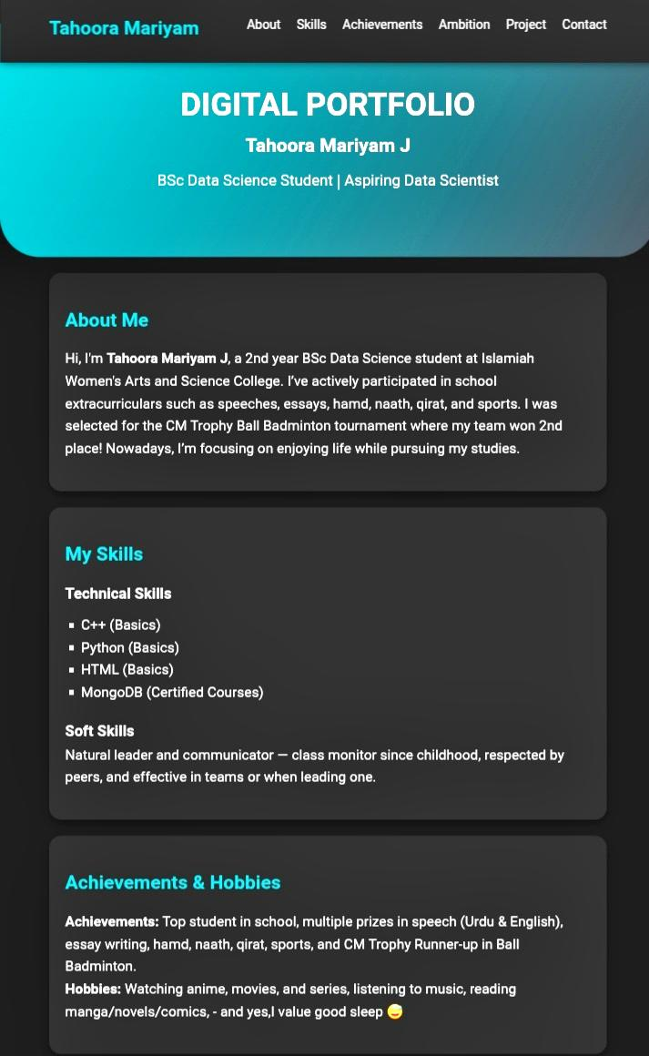
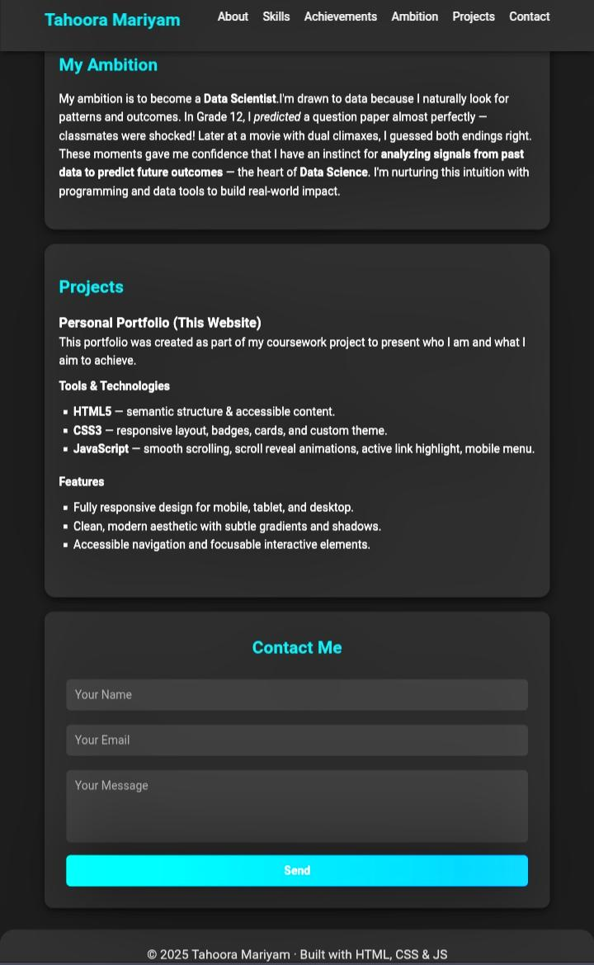
Results and Screenshots

Slide 11
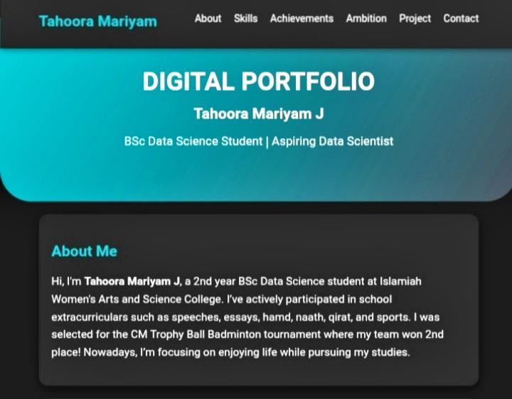
About Me

Slide 12
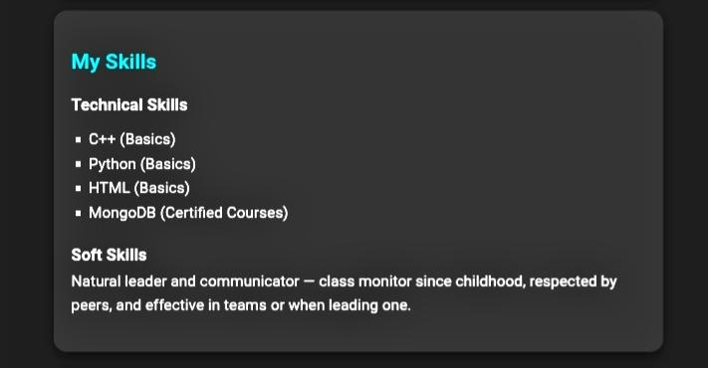
My Skills

Slide 13
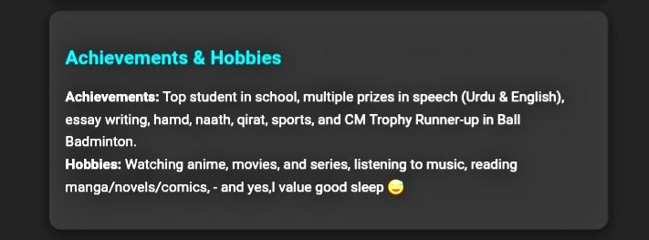
Achievements & Hobbies

Slide 14
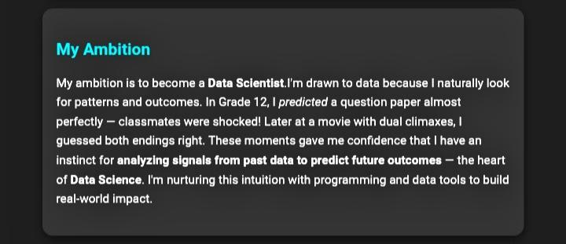
My Ambition

Slide 15
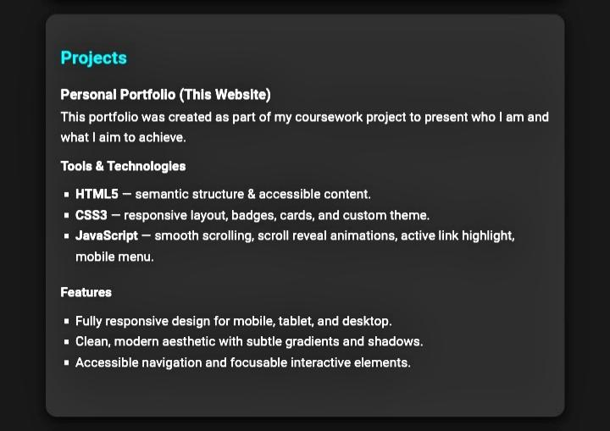
My Project

Slide 16
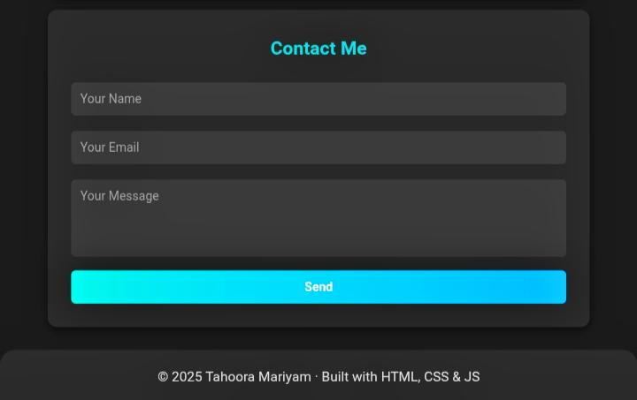
Contact Me

Slide 17
Conclusion
A clean, modern portfolio that clearly communicates identity and strengths.
Demonstrates practical use of HTML, CSS, and JavaScript for a real deliverable.
Organizes academics, achievements, and goals for teachers and recruiters.
Future-ready: easy to add resume download, more projects, and blog posts.
Supports the long-term ambition to become a Data Scientist.

Slide 18

Github Link
Github Link : https://github.com/TahooraMariyam/FWD---Digital-Portfolio-.git
Portfolio Link : https://codepen.io/TAHOORA-MARIYAM/pen/WbQBYNK

Slide 19
Thank you

